Slide 1
Section 7.3 Independent and Dependent Events with Tree Diagram

Slide 2
Independent Events:
2 events that do not affect each other’s outcome
ie: flipping a coin → outcome from each flip is independent
rolling a dice → each roll has a different outcome
drawing cards from a deck with replacement, each card that is drawn is independent
If 2 events “A” and “B” are independent, then the outcomes of them both happening together is product of their probability
Note: This formula only applies when A & B are independent events
© Copyright all rights reserved to Homework depot: www.BCMath.ca

Slide 3
Ex: 2 Dice are rolled, Given the events: A – 1st roll is Odd B – 2nd Roll is a 3 Find P(A & B)
The 2 events are independent
One way to check your answer is to count the number of desired outcomes
Ex: a bias coin is flipped 3 times. P(heads) = 0.75 What is the prob. of getting a Tails, Heads, and then Tails in this order?
The probability of heads is 0.75,
Note: Each event is independent
Then the probability of tails is 0.25
© Copyright all rights reserved to Homework depot: www.BCMath.ca

Slide 4
Ex: The probability of getting an “A” in math 10 is 60% and the probability of getting an “A” in English is 40%. If the probability of getting an “A” in both subjects is 30%, then are the two events independent?
© Copyright all rights reserved to Homework depot: www.BCMath.ca

Slide 5
Event A –getting an “a” in Math Event B – Getting an “B” in Science If both events are independent, then find the following:
© Copyright all rights reserved to Homework depot: www.BCMath.ca

Slide 6
Ex: two spinners are spun. What is the probability that the product will be an odd number?
To have an odd product,
both numbers MUST be odd
b) What is the probability that the product will be an Even number?
To have an even product, either number could be even
1st Method: Add all the cases where the product is even
2nd Method: Subtract the
Complement from 100%
© Copyright all rights reserved to Homework depot: www.BCMath.ca

Slide 7
Dependent Events:
Events “A” and “B” are dependent if the outcome of event “A” affects the outcome of event “B”
Getting a flat tire and being late for work
Drawing two cards from a deck without replacement
Any experiment where something is removed and not replaced
Any event that will alter either the “total number of outcomes” or the “number of desired outcomes”
Create a tree diagram when solving questions involving dependent events
© Copyright all rights reserved to Homework depot: www.BCMath.ca

Slide 8
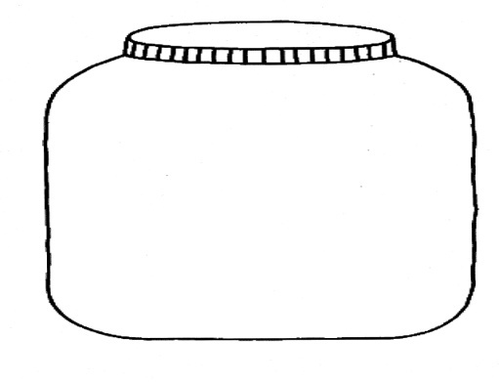
Ex: A jar has 3 red marbles, 2 blue, and 5 green marbles. What is the probability of drawing 3 red if there is no replacement?
The events are dependent of each other, since there are no replacements
Use a tree diagram to display the events
1st Draw: only two possible outcomes: Red and non-red marbles
Each time a marble is drawn, there is one less in the jar
© Copyright all rights reserved to Homework depot: www.BCMath.ca

Slide 9
Ex: 2 cards are drawn without replacement. Find the probability of the following: a) 2 hearts are chosen b) Both cards are not hearts c) Only one card is a heart
The events are dependent of each other, since there are no replacements
Use a tree diagram to display the events
© Copyright all rights reserved to Homework depot: www.BCMath.ca

Slide 10
Challenge: There are “x” number of red marbles and “Y” number of green marbles. If 2 marbles are drawn without replacements, what is the probability of getting a Red first and then a green?
Total number of marbles is “x + y”
© Copyright all rights reserved to Homework depot: www.BCMath.ca

Slide 11
Challenge#2) Bag A contains 4 green and 6 red marbles. Bag B contains 3 green and 7 red marbles. A marble is drawn from bag A and placed into bag B. A marble is then drawn from bag B. what is the probability that a red marble is chosen?
A marble is drawn from bag A
The number of marbles in bag B
will increase
© Copyright all rights reserved to Homework depot: www.BCMath.ca

Slide 12
Ex: Police report that 78% of drivers are given a breath test, 36% a blood test, and 22% both tests.
a) Are giving a DWI suspect a blood test and a breath test mutually exclusive?
b) Are giving the two tests independent?
Soln: State the events we’re interest in.
Let A = {suspect is given a breath test}.
Let B = {suspect is given a blood test}.
a) If the two events are mutually exclusive then:
Since the intersection is not empty, then they are not M.E.
b) If the two events are independent then:
Not equal, so not independent

Slide 13
A man has 2 dimes, 2 nickels, and 2 quarters. If he randomly selects two coins, what is the probability that his value will be 30 cents or more?

